Slide 1
Secure File Encryption and Decryption System Using C++
DSA0105 - Object Oriented Programming with C++
A CAPESTONE PROJECT- REVIEW-1
Presented by:
BHUVANESH H (192524027)
S. SACHIN (192525045)
BALAJI .S.A (1921260146)
G. RAM CHARAN (192525043)
Supervised by
Dr. Jagadeesh K

Slide 2
OBJECTIVE
To develop a secure file encryption and decryption system using C++.
To protect confidential files from unauthorized access using AES-256 encryption.
To enable secure file decryption using the correct encryption key or password.
To implement secure key generation and verification.
To verify file integrity using SHA-256 hashing.
To generate reports showing encryption, decryption, and file verification status

Slide 3
INTRODUCTION
Develop a secure file encryption and decryption system using C++.
Protect files from unauthorized access using AES-256 encryption.
Allow users to encrypt files and decrypt them using the correct key or password.
Verify file integrity using SHA-256 hashing.
Generate reports showing encryption, decryption, and verification status.
Provide a simple, user-friendly interface for secure file management.

Slide 4
PROBLEM STATEMENT
Files stored without encryption may be accessed by unauthorized users, leading to data leakage.
Unencrypted files do not provide sufficient protection for sensitive or confidential information.
Manual file protection and management can be time-consuming and error-prone.
Incorrect encryption keys or passwords can prevent users from successfully decrypting files.
A secure C++ system is needed to provide reliable file encryption, decryption, and integrity checking.

Slide 5
PROPOSED SYSTEM
The system uses C++ to provide secure file encryption and decryption.
Users can select files and encrypt them using the AES-256 algorithm.
Encrypted files can be decrypted using the correct key or password.
Secure key generation helps protect sensitive file contents.
SHA-256 hashing is used to verify file integrity and detect modifications.
The system generates reports showing encryption, decryption, and verification results.

Slide 6
TECHNOLOGIES USED
C++: Implements file selection, encryption, decryption, and reporting.
OpenSSL: Provides cryptographic functions for secure file processing.
AES-256: Encrypts files to protect confidential information.
SHA-256: Generates hashes to help verify file integrity.
GCC (MinGW): Compiles and runs the C++ program.
Visual Studio Code: Used for coding, debugging, and testing.
File Handling: Uses C++ file streams to read and write files.

Slide 7
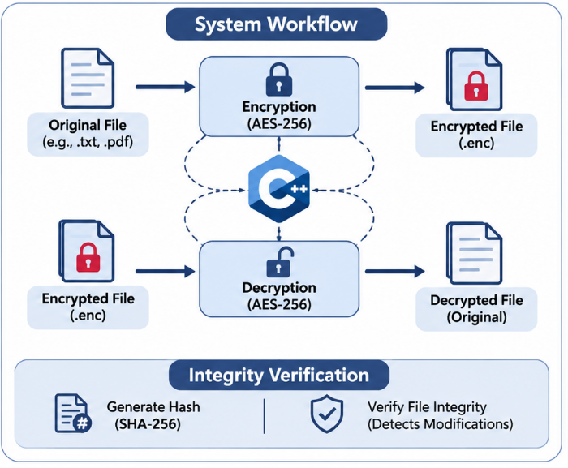
SYSTEM ARCHITECTURE
SYSTEM ARCHITECTURE
User Interface (C++)
File Selection and Operation Menu
Module 1: File Selection and Management
File validation and access checking
Module 2
Encryption and Key Generation
Module 3
Decryption and Key Verification
Module 4: Integrity Verification and Report Generation
SHA-256 hash verification and status reports
OUTPUT
Encrypted File · Decrypted File · Integrity Status · Reports

Slide 8


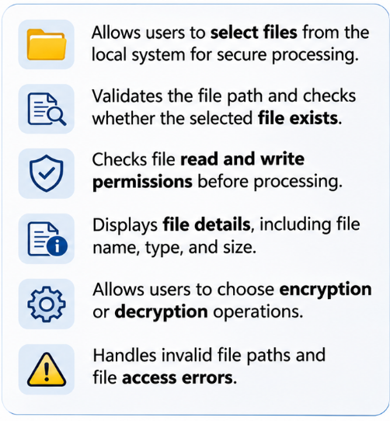
Module 1: File Selection and Management
Allows users to select files from the local system for secure processing.
Validates the file path and checks whether the selected file exists.
Checks file read and write permissions before processing.
Displays file details, including file name, type, and size.
Allows users to choose encryption or decryption operations.
Handles invalid file paths and file access errors.

Slide 9
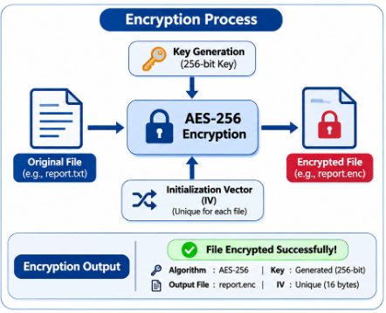
Module 2: Encryption and Key Generation
Allows users to select files that require encryption.
Generates or securely derives a cryptographic key for file protection.
Uses the AES-256 algorithm to encrypt file contents.
Generates a unique initialization vector (IV) for each encryption operation.
Saves the encrypted data in a separate output file.
Displays the encryption status and reports any errors during processing.

Slide 10
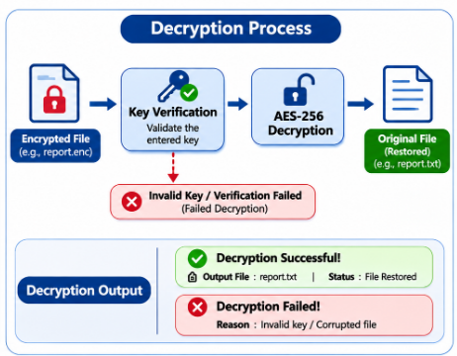
Module 3: Decryption and Key Verification
Allows users to select previously encrypted files for decryption.
Requests the correct encryption key or password to access the protected file.
Uses the AES-256 algorithm to convert encrypted data back into its original form.
Restores the decrypted file only after successful authentication and verification.
Displays the decryption status and error messages for incorrect keys or corrupted files.

Slide 11
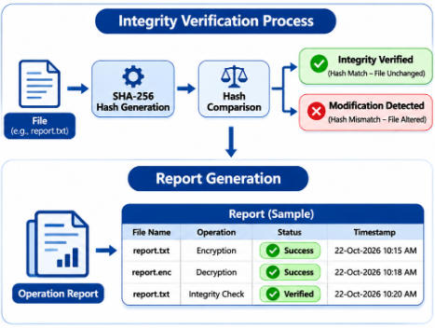
Module 4: File Integrity Verification and Report Generation
Calculates the SHA-256 hash of files to support integrity verification.
Compares the current hash with a previously recorded hash value.
Detects possible file modifications when the hash values do not match.
Records encryption, decryption, and verification operation details.
Generates reports containing file names, operation status, and timestamps.
Displays verification results, including integrity match, mismatch, or processing errors.

Slide 12
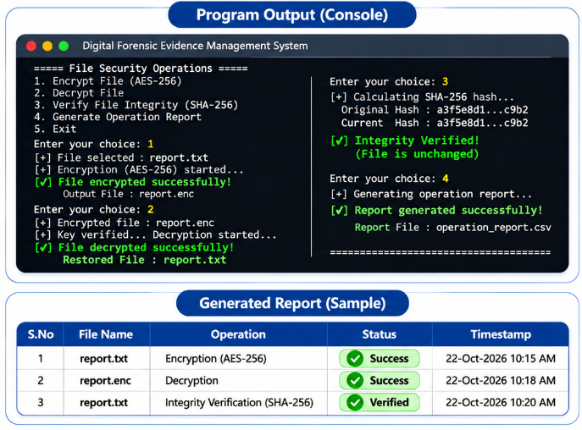
IMPLEMENTATION
Successfully encrypts selected files using AES-256.
Decrypts protected files using the correct key or password.
Restores the original file after successful decryption.
Verifies file integrity using SHA-256 hash comparison.
Displays success or failure messages for each operation.
Generates reports containing file names, operation status, and timestamps.

Slide 13
ADVANTAGES & DISADVANTAGES
ADVANTAGES
DISADVANTAGES
Protects files using AES-256 encryption.
Allows secure file decryption with the correct key.
Detects file modifications using SHA-256 hashing.
Provides simple file management.
Generates reports of file operations.
Losing the encryption key may cause permanent data loss.
Encrypting large files may take more time.
Secure key management can be challenging.
Corrupted files may fail to decrypt.
Requires a compatible cryptographic library such as OpenSSL.

Slide 14
CONCLUSION
The project provides a secure file encryption and decryption system using C++.
AES-256 encryption helps protect confidential files from unauthorized access.
Secure key verification allows authorized users to decrypt files.
SHA-256 hashing helps verify file integrity and detect modifications.
Report generation provides a clear record of file operations.
The system can be enhanced with a graphical interface and improved key management in the future

Slide 15
Thank You!

